Slide 1

Leukemia Classification
CSE 527 Computational Biology
Andrew Wei, nowei@cs.washington.edu

Slide 2
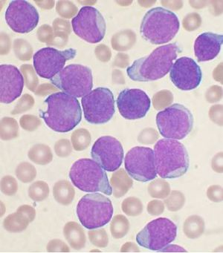
What is Leukemia?
Wikipedia
Notes:
Leukemia:
Blood cancer caused by increased abnormal white blood cell production in the body and
suppresses the production of normal blood cells.

Slide 3
The Data - GSE13159
Name: Microarray Innovations in LEukemia (MILE) study: Stage 1 data
Data collected from 11 centers across 3 continents
Size: ~616 MB
Data released on Sept 30, 2009
n = 2096 patients
d = 17,788 genes
18 classes
Notes:
MILE dataset
which is a leukemia dataset made from: 2096 blood or bone marrow samples from acute and chronic leukemia patients,
Has: 17,788 genes, and 17 subtypes of leukemia and 1 healthy group

Slide 4
Data breakdown
Name | Count
MDS | 207
CLL | 448
AML complex aberrant karyotype | 52
AML with normal karyotype + other abnormalities | 347
c-ALL/Pre-B-ALL without t(9;22) | 237
T-ALL | 174
CML | 76
AML with t(11q23)/MLL | 38
ALL with t(12;21) | 58
Name | Count
Non-leukemia and healthy bone marrow | 73
c-ALL/Pre-B-ALL with t(9;22) | 122
AML with t(8;21) | 40
ALL with hyperdiploid karyotype | 40
ALL with t(1;19) | 36
Pro-B-ALL with t(11q23)/MLL | 70
AML with t(15;17) | 37
AML with inv(16)/t(16;16) | 28
mature B-ALL with t(8;14) | 13
Notes:
We started by counting all of the classes to get an idea of data distribution
High is 448
Low is 13
Data is imbalanced

Slide 5

Goal
Understand how gene expression patterns are different in different subtypes of leukemia
Challenges:
Interpreting results
Determining significance of results
(I didn’t know we had to do a presentation until last week)
Notes:
We focus more on interpreting our results than the papers we’ve seen that try to distinguish between methods that obtain classification results.
Our criteria of success is being able to identify subtypes of leukemia and the genes that are associated with leukemia or with certain subtypes of leukemia.

Slide 6
Approach
90/10 train/test split
Finding significant features among different leukemia subtypes
Check for significant features (applying Bonferroni correction)
Look at most common significant features
Logistic Regression
Check with all features/only with significant features and different data normalization methods
Check similarity between learned weights
Analyze learned weights
K-Nearest Neighbors
Notes:
We used a 90/10 train and test split
Essentially we went with the tried and true method of throwing spaghetti against the wall and seeing what sticks.
So I wanted to try out several different approaches and see how they performed
Significant features
see which genes were significant for each subtype of leukemia
Logistic regression
Try different settings
Checked and analyzed the learned weights
K-nearest neighbors

Slide 7
Finding significant features
Leukemia sub-type (cont.) | Number of significant features
c-ALL/Pre-B-ALL without t(9;22) | 817
T-ALL | 793
CML | 195
AML with t(11q23)/MLL | 271
ALL with t(12;21) | 724
c-ALL/Pre-B-ALL with t(9;22) | 731
AML with t(8;21) | 373
ALL with hyperdiploid karyotype | 581
ALL with t(1;19) | 612
Pro-B-ALL with t(11q23)/MLL | 689
AML with t(15;17) | 428
AML with inv(16)/t(16;16) | 351
mature B-ALL with t(8;14) | 48
Bonferroni correction (p=0.05, m=17788)
Performed on training set
“Non-leukemia and healthy bone marrow” vs. others
1,408 significant features in total
Leukemia sub-type | Number of significant features
MDS | 39
CLL | 956
AML complex aberrant karyotype | 220
AML with normal karyotype + other abnormalities | 522
Notes:
By comparing
Looking at the numbers, realized that there’s probably overlap

Slide 8

Jaccard similarity of significant features
$$J\left(A,B\right)=\frac{\left|A∩B\right|}{\left|A∪B\right|}$$
Notes:
More green
Gives us an idea of how similar the significant features between leukemia subtypes are.
Some notable things are that c-ALL/Pre-B-ALL without t(9;22) shares similar significant features with c-ALL/Pre-B-ALL with t(9;22), with a 70% overlap.

Slide 9
Checking the common significant features
# shared labels | # genes
16 | 1
15 | 17
14 | 31
13 | 30
12 | 51
11 | 64
10 | 75
9 | 110
8 | 101
7 | 128
6 | 111
5 | 103
4 | 116
3 | 125
2 | 130
1 | 215
# shared labels | Name of gene
16 | 10487_at
15 | 1116_at
15 | 116362_at
15 | 10123_at
15 | 1118_at
15 | 10562_at
… | …
* We have information on which labels the gene is shared by, but it wouldn’t fit on the slide.
Notes:
Google, I mean research, the top shared significant features to see significance.

Slide 10
Example: Looking at the most common significant gene
Gene: 10487_at
Shared by: 16 leukemia subtypes
Description: CAP1 - CAP, adenylate cyclase-associated protein 1 (yeast)
Shared by:
CLL, AML complex aberrant karyotype, AML with normal karyotype + other abnormalities, c-ALL/Pre-B-ALL without t(9;22), T-ALL, CML, AML with t(11q23)/MLL, ALL with t(12;21), c-ALL/Pre-B-ALL with t(9;22), AML with t(8;21), ALL with hyperdiploid karyotype, ALL with t(1;19), Pro-B-ALL with t(11q23)/MLL, AML with t(15;17), AML with inv(16)/t(16;16), mature B-ALL with t(8;14)
Not shared by: MDS
Notes:
Top shared gene

Slide 11
Checking significance
Gene: 10487_at
Shared by: 16 leukemia types
Description: CAP1 - CAP, adenylate cyclase-associated protein 1 (yeast)
From [Xie, Shen, Tan, Li, Song, Wang 2017]: “CAP1 […] was under-expressed in breast and leukemia cancers as compared to that in normal tissue.”
Notes:
Some indication that this can identify important genes

Slide 12

Logistic Regression
Notes:
Simple model
Maintain interpretability.
Scikit learn

Slide 13
Learning settings
Used 5-fold cross validation
L1 regularization
With all features vs. with significant features
Different normalization schemes
1 vs. all classification scheme
Notes:
L1 because we want a lot of the weights to be 0.

Slide 14
Normalization schemes
Don’t normalize
Normalize across entire training dataset
Normalize by healthy patient data in training dataset
Notes:
We wanted to see how different data preparation schemes impacted the accuracy of the results

Slide 15
Results of 5-fold cross-validation
Normalization Scheme | w/ all features |  | w/ significant features
 | Top 1 acc. | Top 5 acc. | Top 1 acc. | Top 5 acc.
Don’t normalize | 0.895 | 0.995 | 0.870 | 0.987
Normalize across entire training dataset | 0.898 | 0.988 | 0.881 | 0.986
Normalize by healthy patient data in training dataset | 0.907 | 0.991 | 0.884 | 0.984

Slide 16
Results
Normalization Scheme | w/ all features |  | w/ significant features
 | Top 1 acc. | Top 5 acc. | Top 1 acc. | Top 5 acc.
Don’t normalize | 1.0 | 1.0 | 1.0 | 1.0
Normalize across entire training dataset | 1.0 | 1.0 | 1.0 | 1.0
Normalize by healthy patient data in training dataset | 1.0 | 1.0 | 1.0 | 1.0
Train
Normalization Scheme | w/ all features |  | w/ significant features
 | Top 1 acc. | Top 5 acc. | Top 1 acc. | Top 5 acc.
Don’t normalize | 0.919 | 1.0 | 0.881 | 0.990
Normalize across entire training dataset | 0.919 | 0.995 | 0.857 | 0.981
Normalize by healthy patient data in training dataset | 0.900 | 0.995 | 0.843 | 0.971
Test
Notes:
Our idea for why not normalizing is the best is that allows the model to learn the significance of each feature by itself and determine the best weights without augmenting the data by converting everything into relative values.
There might be other reasons:
Some genes might strictly be related to inhibition or presence of certain leukemia subtypes, so not normalizing actually better expresses the degree in which some subtypes are present or not.

Slide 17
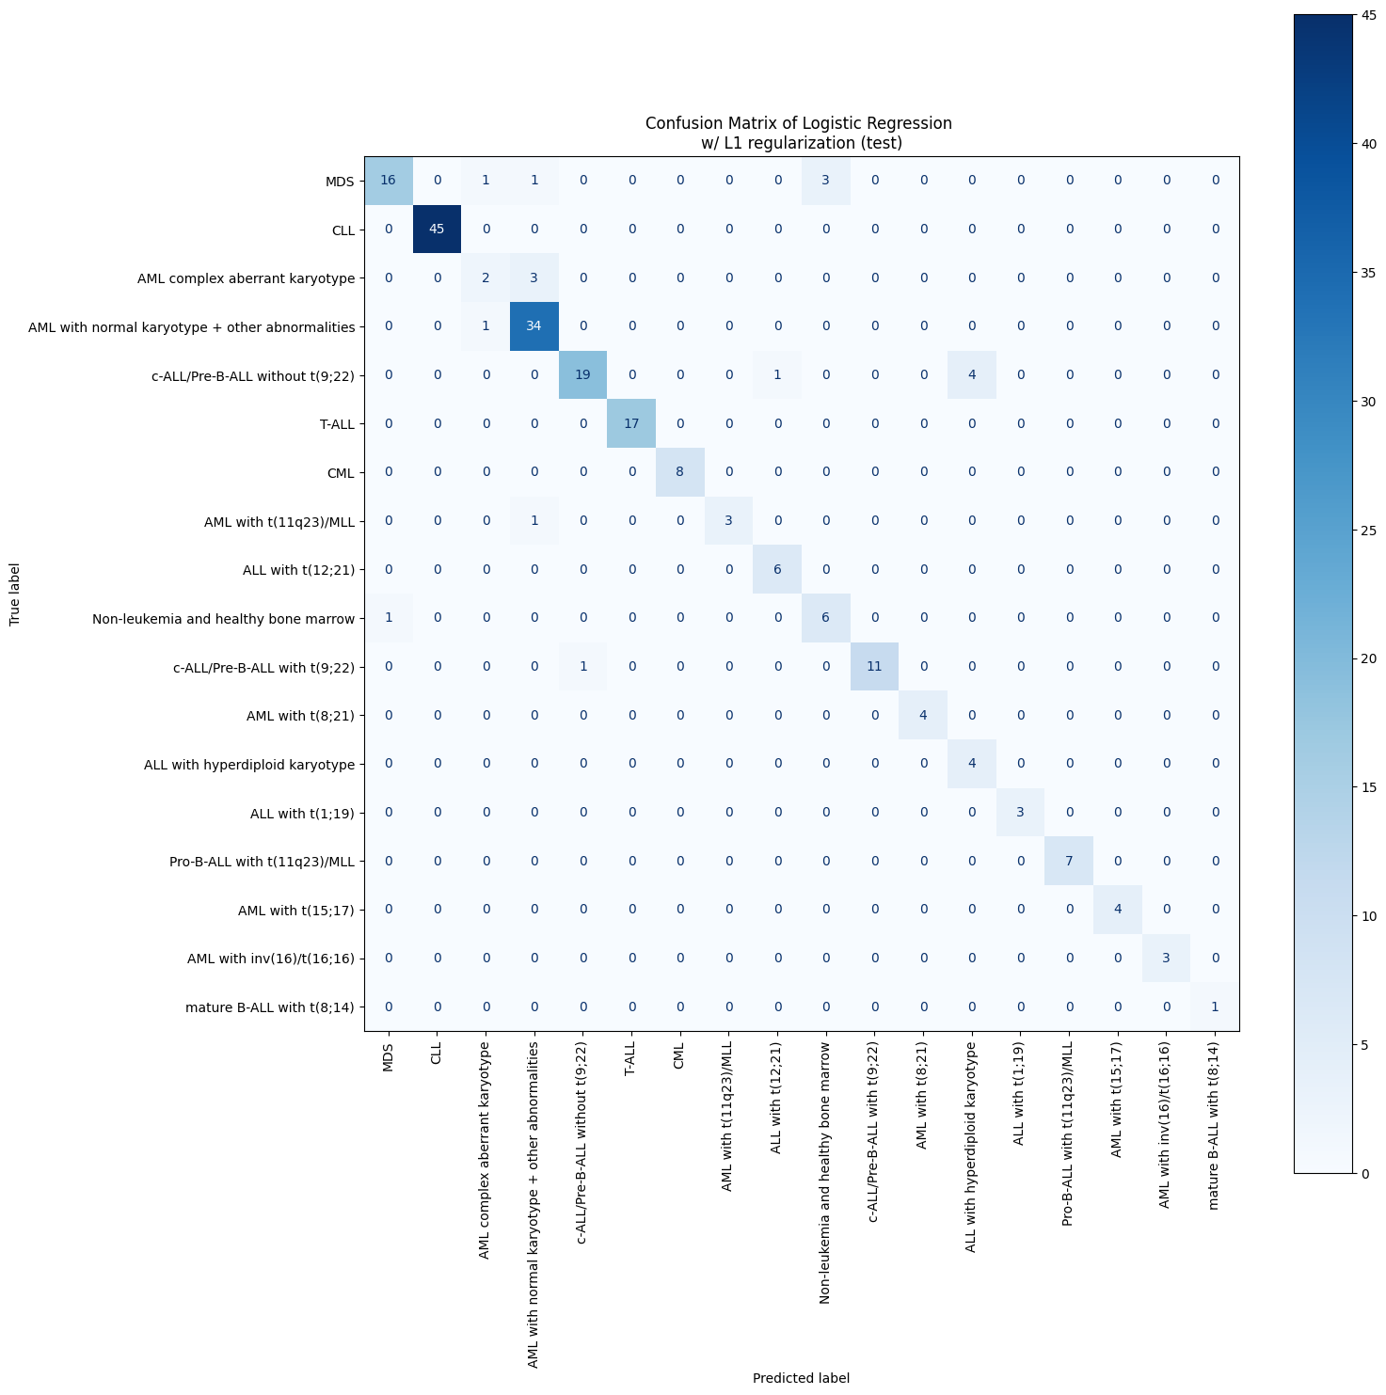
Reflecting on results
* results from using all features and no normalization
Notes:
Not too many errors, but the largest errors are when we misclassify
c-ALL/Pre-B-ALL without t(9;22) as ALL with hyperdiploid karyotype and
MDS as non-leukemia and healthy bone marrow.
Mistakes tell us about the feature space in which this data exists

Slide 18
Features used by leukemia sub-type model
Leukemia Sub-type | # zeros | # non-zero
MDS | 15400 | 2388
CLL | 17004 | 784
AML complex aberrant karyotype | 17258 | 530
AML with normal karyotype + other abnormalities | 15227 | 2561
c-ALL/Pre-B-ALL without t(9;22) | 15381 | 2407
T-ALL | 16507 | 1281
CML | 17040 | 748
AML with t(11q23)/MLL | 17080 | 708
ALL with t(12;21) | 17072 | 716
Leukemia Sub-type | # zeros | # non-zero
Non-leukemia and healthy bone marrow | 17235 | 553
c-ALL/Pre-B-ALL with t(9;22) | 16414 | 1374
AML with t(8;21) | 17336 | 452
ALL with hyperdiploid karyotype | 16999 | 789
ALL with t(1;19) | 17132 | 656
Pro-B-ALL with t(11q23)/MLL | 16959 | 829
AML with t(15;17) | 17202 | 586
AML with inv(16)/t(16;16) | 17481 | 307
mature B-ALL with t(8;14) | 17544 | 244
Total number of genes: 17788
Notes:
This is in line with the idea that not all genes are relevant in identifying whether someone has leukemia or not.
Number doesn’t match the significant features found because we also need knowledge about classifying what isn’t the specific leukemia subtype.

Slide 19

Cosine Similarity to compare learned weights
$$C\left(A,B\right)=\frac{A⋅B}{\left\|A\right\|×\left\|B\right\|}$$
* results from using all features and no normalization
Notes:
Cosine similarity is a measure of similarity between two non-zero vectors of an inner product space.
The more green means that the more similar the weights are and the more red means the more opposite or opposed the weight vectors are to each other.
So this table gives us an idea of how similar the learned weights were to each other.

Slide 20
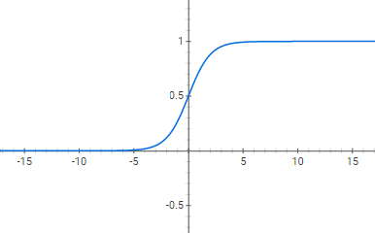
Most heavily weighted weights
* results from using all features and no normalization
MDS
CCL
Highest
Name | Coefficient
66000_at | 0.100164
2706_at | 0.091647
158809_at | 0.088469
100130703_at | 0.083912
9518_at | 0.083138
Name | Coefficient
27033_at | 0.079577
130367_at | 0.067018
5923_at | 0.052974
81537_at | 0.043758
2823_at | 0.041918
…
…
…
Lowest
Name | Coefficient
285299_at | -0.073488877
388951_at | -0.074094855
51673_at | -0.079185137
7266_at | -0.144620158
56884_at | -0.205755898
Name | Coefficient
79872_at | -0.04386
100131644_at | -0.04524
85358_at | -0.04816
390058_at | -0.11016
3892_at | -0.16053
…
Notes:
Names of genes that we can check out.
In logistic regression a more positive product between weights and the feature means that it’s more likely to be some class
And more negative products indicate that it’s less likely to be some class.
We can use these weights as indicators of specific subtypes of leukemia.
Haven’t checked them out yet because there’s a lot of them, which is why one of the challenges is determining the significance of the results because there’s so many results.

Slide 21
K-Nearest Neighbors
Instance-based learning
Parameters to tune:
K, i.e. # of neighbors
n = 2096 patients
Whether to use significant features or all the features
Notes:
K-nearest neighbors is an instance-based learning algorithm, so it uses the data to make predictions instead of learning a model to make predictions.
How it works is we put in a test point and the predictions are based on the k closest neighbors from the training data
<<<<<
Some classes don’t have many members, so we can’t make k too high.

Slide 22
Results
# of neighbors | w/ all features |  | w/ significant features
 | Top 1 acc. | Top 5 acc. | Top 1 acc. | Top 5 acc.
3 | 0.767 | 0.881 | 0.790 | 0.895
5 | 0.771 | 0.914 | 0.790 | 0.929
10 | 0.795 | 0.962 | 0.819 | 0.962
15 | 0.786 | 0.967 | 0.819 | 0.952
20 | 0.790 | 0.971 | 0.786 | 0.952
Notes:
Top 5 accuracy is decent
Top 1 leaves things to be desired
Further analysis could give some idea of space in terms of what kind of errors are being made.

Slide 23
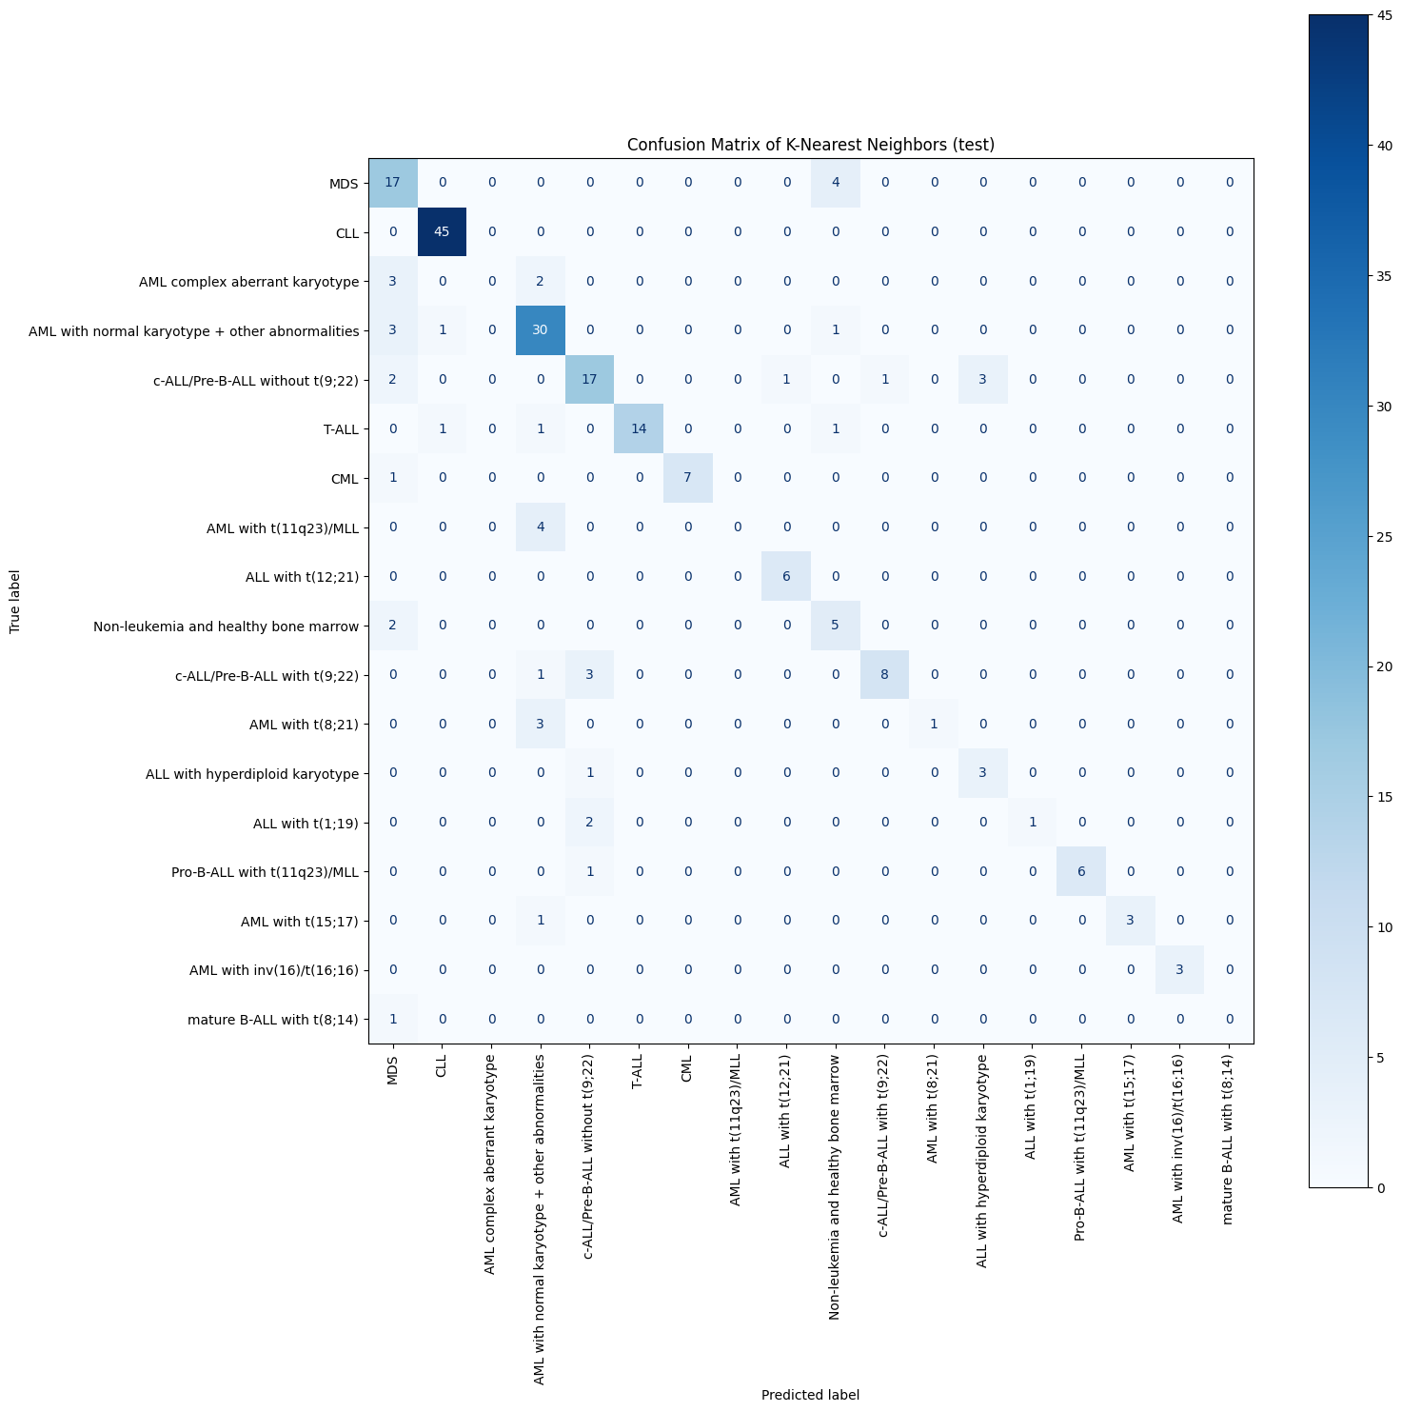
Reflecting on results
Similar results, but more different errors
Notes:
Model made some of the same errors, but with more types of errors.
Still misclassifies
c-ALL/Pre-B-ALL without t(9;22) as ALL with hyperdiploid karyotype and
MDS as non-leukemia and healthy bone marrow.

Slide 24
Future Work
Further examine and interpret the results and errors obtained
Alternative 1 vs. all classification
Make a separate model for each leukemia subtype made by selecting out and training on the significant features
Try different regularizers and machine learning methods
Address data imbalance
Notes:
1. Do this in the near future for the report. Especially for significance of gene data and leukemia subtype gene weights
Only went with L1 because we wanted to incentivize the weights towards 0 if they aren’t impactful

Slide 25
Conclusion
Analyzing shared significant features seems to be useful
Logistic regression models can get close to 100% accuracy with MILE dataset
K-Nearest Neighbors is okay, but not that great
Notes:
Analyzing shared significant features seems like a possible method for finding important genes involved in a disease
Logistic regression works pretty well in terms of classification
K-Nearest Neighbors doesn’t work as well as Logistic Regression

Slide 26

Questions?

Slide 27

Thanks!

